Slide 1
The Life, Death, and Resurrection of Sabbath School
170415 alberta conf ss

Slide 2
1700s
Children spent Sundays — their only day off from work — terrorizing neighborhoods, and parents were at a loss as to how to tame them
Christian evangelist Robert Raikes
Washed them
Taught them hygiene
Bible was the textbook
Taught doctrines, prayers, and hymns

Slide 3
Decline
1950s-60s – Sunday and Sabbath Schools had their heyday
1970 – Sunday school and church in general, like many traditional institutions, fell victim to society (questioned authority, government draft, society’s injustices, the church)
1980s – megachurches place emphasis on divine service
1997-2004: churches lost tens of thousands of Sunday school programs, according to Barna, across denominations.
2004-2010: Sunday school attendance dropped nearly 40% among Evangelical Lutheran churches in America and almost 8% among Southern Baptist churches
UK: Only 5% of kids go to Sunday school
NZ: 11% percent of elementary school students were enrolled in Sunday school in 1985, down from 50% in 1950.
Canada: Sunday school enrollment and membership in mainstream Protestant churches plummeted from 65% in 1931 to 27% in 2001

Slide 4
Dr. C. E. Autrey, SBC Leader:
"The most effective method in evangelism in the twentieth century is the Sunday school... It should be the contact agency of the church. All ages and types of people are visited and enrolled in the Bible school. Here their hearts are warmed with Bible teaching. They are then led to remain for worship. They are brought into the Bible school, worship service, Christ, and church membership.”
[This philosophy is largely responsible for Southern Baptists growth to be the largest Protestant denomination in the US.]

Slide 5
“The object of the SS work should be the ingathering of souls.” (CSSW61)
Sabbath School is “one of the greatest instrumentalities to bring souls to Christ.” (CSSW10)

Slide 6
Ministry of Healing 149
The monotony of our service for God needs to be broken up. Every church member should be engaged in some line of service for the Master. Some cannot do so much as others, but everyone should do his utmost to roll back the tide of disease and distress that is sweeping over our world. Many would be willing to work if they were taught how to begin. They need to be instructed and encouraged.
Every church should be a training school for Christian workers. Its members should be taught how to give Bible readings, how to conduct and teach Sabbath-school classes, how best to help the poor and to care for the sick, how to work for the unconverted…

Slide 7
Four Goals of SS
Change the World – Global Missions
Change the Community – Evangelism
Change the Church – Fellowship
Change the Individual – Word

Slide 8
1. World Missions
Videos
Mission Story Reading
Special Mission Projects
Church buildings
Stewardship
Understanding of the World Church
Church Growth

Slide 9
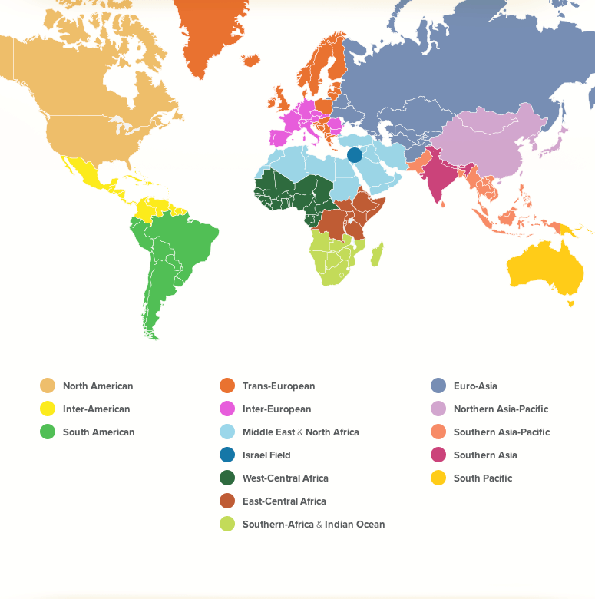

Slide 10
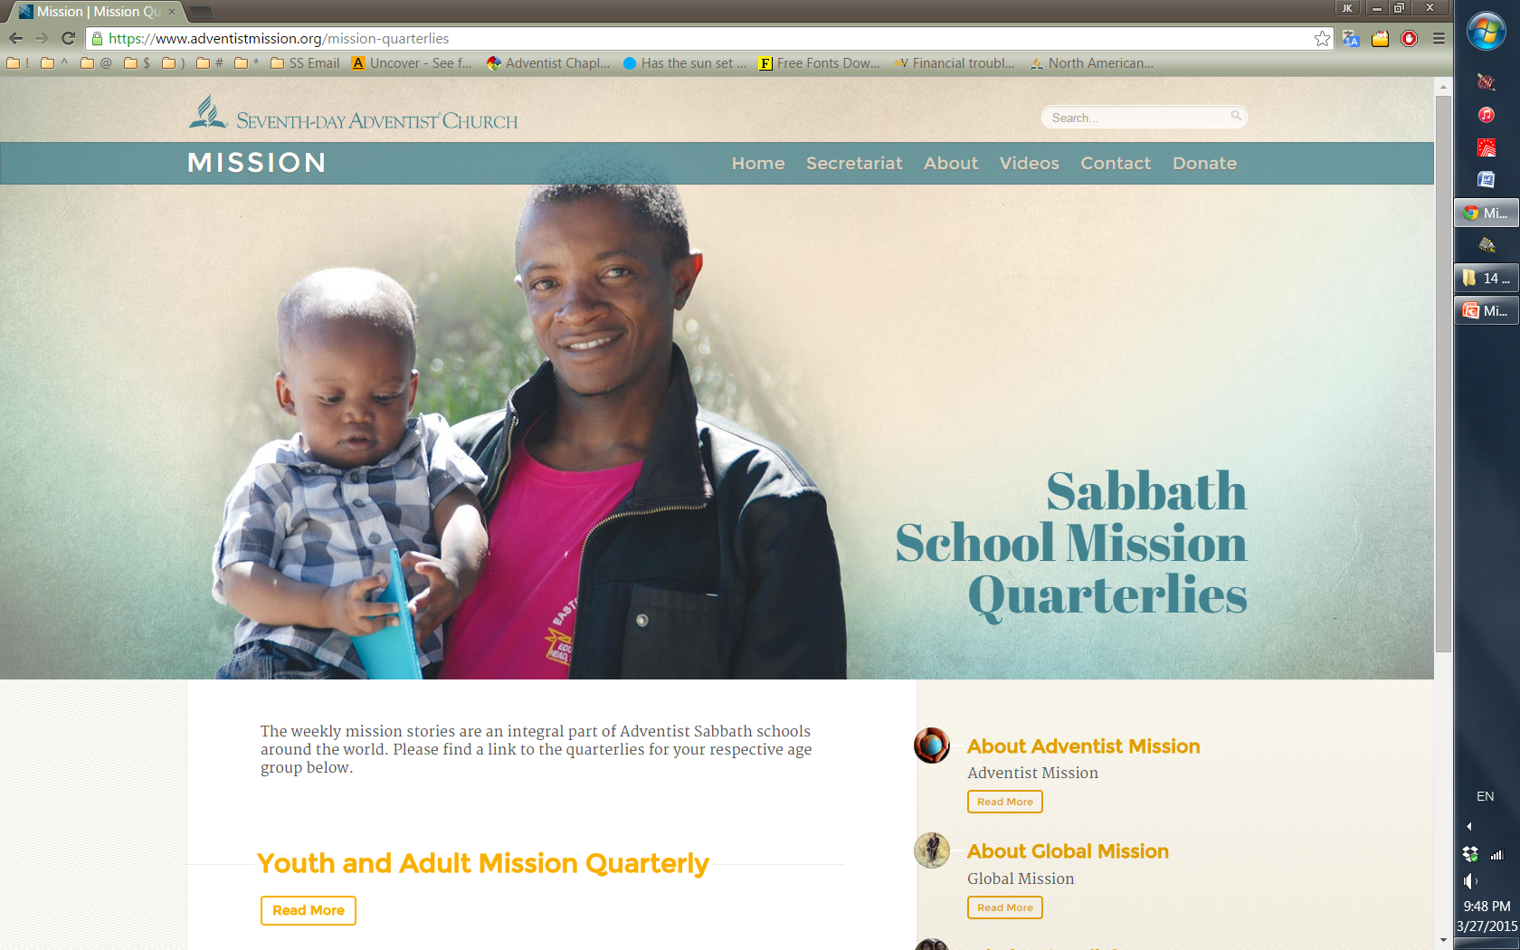

Slide 11
Gospel Workers p.465-466
To show a liberal, self-denying spirit for the success of foreign missions is a sure way to advance home missionary work; for the prosperity of the home work depends largely, under God, upon the reflex influence of the evangelical work done in countries afar off. It is in working to supply the necessities of others that we bring our souls into touch with the Source of all power. The Lord has marked every phase of missionary zeal that has been shown by His people in behalf of foreign fields. He designs that in every home, in every church, and at all the centers of the work, a spirit of liberality shall be shown in sending help to foreign fields, where the workers are struggling against great odds to give the light to those who sit in darkness. That which is given to start the work in one field will result in strengthening the work in other places.

Slide 12
Worldwide Sabbath School attendance is actually higher than church attendance.
In some places, Sabbath School starts at 9 AM and people know they have to come by 8 to get a seat.
Sabbath School research around the world has showed us that the main complaint people have is that it’s so routine and boring.
Stats from recent GC Session:
1960 Global south 54%; Global north 46%
2015 Global south 92%; Global north 7%

Slide 13
2. Evangelism
Branch Sabbath Schools
VBS
Training with Pastor / Personal Ministries Director
TCC / Discipleship
ACS / Community Center / Disaster Relief
GLOW Tracts
Outreach for different language groups or different institutions
Mapping out district
Mailing books
Door to door
Prison / Campus Ministry

Slide 14
Glenn Valley Central Church
Brenton Lake Company
Glenn Valley East Church
Glenn Valley University Branch Sabbath School
Glenn Valley Southeast Company
Mead Church
North Mead Company
Basilton Branch Sabbath School
Mead Lake Company
Morgan Library Branch Sabbath School
Glennmont Branch Sabbath School

Slide 15
Branch Sabbath School / VBS
“Parents who can be approached in no other way are frequently reached through their children. Sabbath school teachers can instruct the children in the truth, and they will, in turn, take it into the home circle. But few teachers seem to understand the importance of this branch of the work.” – 4T 70

Slide 16
Branch Sabbath Schools
1. Swarm: church planting BSS
- different location, same materials
- Branch SS -> Company -> Church
2. Strawberries Runners - outreach BSS
- Sabbath Afternoons or any day of the week – 2-4 gather to study the Bible for the sole purpose of church planting

Slide 17
Who?
Homes of isolated members / Former members
Colporteur / Ingathering / Hospital visit interests
Sabbath guests
Bible school interests / home visitation interests
VBS interests and their parents
Public efforts / ACS / evangelistic series
Non-Adventist church friends / radio, TV, Bible school contacts
Church members who are not ss members
Friends, relatives, business associates
Prison ministry

Slide 18
Where?
How?
Private homes
Public buildings
Nursing homes
Prisons
Online?
Hoster
Leader
Prayer
Teacher
1. Welcome - Hoster
2. Song service - Leader
3. Prayer - Prayer
4. Bible lesson - Teacher

Slide 19
"First the children, then their parents, then a branch Sabbath school, and then the evangelistic meeting.“

Slide 20
Ideas
Story hour with children
Bible marking class
Bible discussion
Adult program with VBS
Continuation of VBS

Slide 21
3. Fellowship
Carefully nurturing new members
Pair off prayers
Potluck
Socials to save
Visitations and Invitations
Class Directory
Welcoming Division
One year Discipleship class
Plan a whole year out of social events

Slide 22
Many professed Christians, in seeking church relationship, think only of themselves. They wish to enjoy church fellowship and pastoral care. They become members of large and prosperous churches, and are content to do little for others. In this way they are robbing themselves of the most precious blessings. Many would be greatly benefited by sacrificing their pleasant, ease-conducing associations. They need to go where their energies will be called out in Christian work and they can learn to bear responsibilities.
{MH 151.3}

Slide 23
http://www.instepwithjesus.org/

Slide 24
4. Word
Teacher’s Resources
Bible
EGW Notes
Teacher’s Guide
ABSG / Quarterly

Slide 25
Peter’s Sermon
13 of the 26 verses = Scripture (OT)
11 of the 26 verses = explanation / meaning
2 of the 26 verses = appeal / action
RESULT = 3000 baptisms

Slide 26
Scripture Quarterly
Meaning Opinion
Appeal Bell

Slide 27
Basics
teach people how to read the word of God
teach people how to express themselves
teach people how to listen (executive leaders spend 70% time listening)
teach people how to witness

Slide 28
“Those who study the Bible with a sincere desire to know and do the will of God will become wise unto salvation. The Sabbath School is an important branch of the missionary work, not only because it gives to young and old a knowledge of God’s Word, but because it awakens in them a love for its sacred truths and a desire to study it for themselves; above all, it teaches them to regular their lives by its holy teachings.” – 5T 389

Slide 29
“In some schools, I am sorry to say, the custom prevails of reading the lesson from the lesson sheet. This should not be. It need not be, if the time that is often needlessly and even sinfully employed, were given to the study of the Scriptures. There is no reason why SS lessons should be less perfectly learned by teachers or pupils than are the lessons of the day school. They should be better learned, as they treat of subjects infinitely more important. A neglect here is displeasing to God.” – SCCW 117-118

Slide 30
SS Council
Highest Authority within SS Organization
Structure (regular monthly mtgs)
Accountability (attendance) teleconference or in-person
Notice (before)
Agenda (during)
Minutes (after)
Mission Strategies and Prayer (objectives: soulwinning)
Fellowship (encouragement)
Teacher Training – watch self-recordings
Prayerful Planning
Communication with local church board

Slide 31
SS Council Strategies
2016 – clone year
2017 – branch year
Resurrect SS Leadership
Share philosophy and methods with SS workers through discussions and meetings
Establish SS council vision

Slide 32
Organization
Establish teamwork, classes, teachers, secretaries, members, leaders, hosts, and prayer-ers.
Secretary – attendance, visitation records, phone, socials
Leaders – plan logistics
Host – clean, prepare, welcome
Teachers – teach
Children’s programs

Slide 33
Training
How to Teach better
How to do Visitations
Clinics one hour before sundown
How to engage other denominations
Simulations
Mid-week trainings / prayer meetings
4. Character
Deal with complaining
Troubleshooting
5. Evangelistic Strategies
Series / harvests
Baptisms

Slide 34
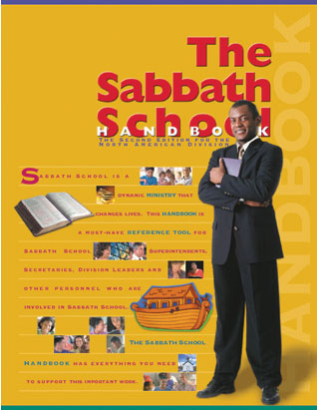
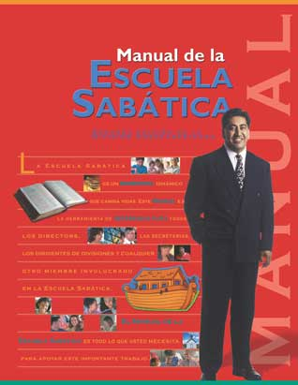
Resources
sabbathschoolpersonalministries.org
ssnet.org
Sabbath School University
Counsels on Sabbath School Work
Sabbath School Handbook
Sabbath School Toolbox magazine

Slide 35
Church at Work
Why do not believers feel a deeper, more earnest concern for those who are out of Christ? Why do not two or three meet together and plead with God for the salvation of some special one, and then for still another? In our churches let companies be formed for service. Let different ones unite in labor as fishers of men. Let them seek to gather souls from the corruption of the world into the saving purity of Christ's love.
The formation of small companies as a basis of Christian effort has been presented to me by One who cannot err. If there is a large number in the church, let the members be formed into small companies, to work not only for the church members, but for unbelievers. If in one place there are only two or three who know the truth, let them form themselves into a band of workers. {7T 21-22}

