Slide 1
“In some schools, I am sorry to say, the custom prevails of reading the lesson from the lesson sheet. This should not be. It need not be, if the time that is often needlessly and even sinfully employed, were given to the study of the Scriptures. There is no reason why SS lessons should be less perfectly learned by teachers or pupils than are the lessons of the day school. They should be better learned, as they treat of subjects infinitely more important. A neglect here is displeasing to God.” – SCCW 117-118

Slide 2
Church at Work
Why do not believers feel a deeper, more earnest concern for those who are out of Christ? Why do not two or three meet together and plead with God for the salvation of some special one, and then for still another? In our churches let companies be formed for service. Let different ones unite in labor as fishers of men. Let them seek to gather souls from the corruption of the world into the saving purity of Christ's love.
The formation of small companies as a basis of Christian effort has been presented to me by One who cannot err. If there is a large number in the church, let the members be formed into small companies, to work not only for the church members, but for unbelievers. If in one place there are only two or three who know the truth, let them form themselves into a band of workers. {7T 21-22}

Slide 3
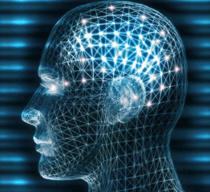
How to Increase Intelligence

Slide 4
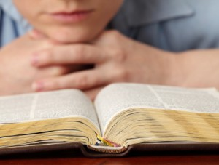
Bible
The mind will enlarge if it is employed in tracing out the subjects of the Bible, comparing scripture with scripture, and spiritual things with spiritual. There is nothing more calculated to strengthen the intellect than the study of the Scriptures. No other book is so potent to elevate the thoughts, to give vigor to the faculties, as the broad, ennobling truths of the Bible. If God's word were studied as it should be, men would have a breadth of mind, a nobility of character, and a stability of purpose that is rarely seen in these times. {CE 58}

Slide 5
Intelligence
The study of the Bible taxes the mind of the worker, strengthens the memory, and sharpens the intellect more than the study of all the subjects which philosophy embraces. The Bible contains the only truth that purifies the soul, and is the best book for intellectual culture.—Review and Herald, Dec. 8, 1885.

Slide 6
Benefit #1: Overcome Sin
Build a wall of scriptures around you, and you will see that the world cannot break it down. Commit the Scriptures to memory, and then throw right back upon Satan when he comes with his temptations, "It is written." This is the way that our Lord met the temptations of Satan, and resisted them. {RH April 10, 1888}
Psalms 119:11 Thy word have I hid in mine heart, that I might not sin against thee.

Slide 7
Benefit #2: Quick Recall
God will flash the knowledge obtained by diligent searching of the Scriptures, into their memory at the very time when it is needed. {Mar 45}
Prayer Witnessing
Bible Study Movements

Slide 8
Benefit #3: Be Like Jesus
Matthew 4:4 But he answered and said, It is written…
6 And saith unto him, If thou be the Son of God, cast thyself down: for it is written…
7 Jesus said unto him, It is written again….
10 Then saith Jesus unto him, Get thee hence, Satan: for it is written…

Slide 9
Too Many Benefits
John 21:25 And there are also many other things which Jesus did, the which, if they should be written every one, I suppose that even the world itself could not contain the books that should be written. Amen.

Slide 10
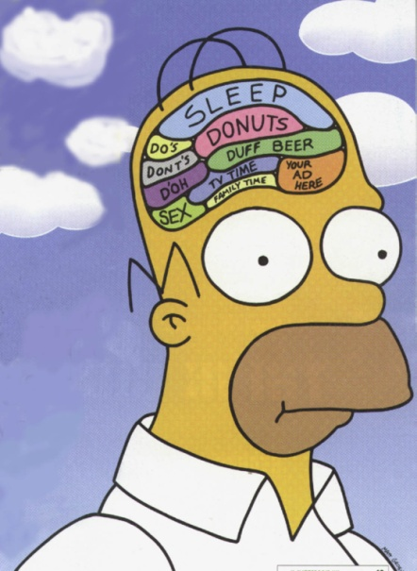
Myth #1: I Am Not Intelligent
Nothing else will so help to give them a retentive memory as a study of the Scriptures. {CT 483}
Those who embrace the truth should seek a clear understanding of the Scriptures, and an experimental knowledge of a living Saviour. The intellect should be cultivated, the memory taxed. All intellectual laziness is sin, and spiritual lethargy is death. {GW92 18}

Slide 11
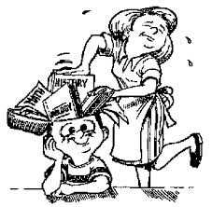
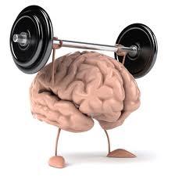
Space vs. Muscle

Slide 12
The human intellect must gain expansion and vigor and acuteness and activity. It must be taxed to do hard work, or it will become weak and inefficient. Brain power is required to think most earnestly; it must be put to the stretch to solve hard problems and master them, else the mind decreases in power and aptitude to think. The mind must invent, work, and wrestle, in order to give hardness and vigor to the intellect…{FE 225}

Slide 13
Myth #2: I Have No Time
Keep your Bible with you. As you have opportunity, read it; fix the texts in your memory. Even while you are walking the streets, you may read a passage, and meditate upon it, thus fixing it in the mind. {CE 58}
Several times each day precious, golden moments should be consecrated to prayer and the study of the Scriptures, if it is only to commit a text to memory, that spiritual life may exist in the soul… {4T 459}

Slide 14
The cultivation of the intellect need not be prevented by poverty, humble origin, or unfavorable surroundings. Only let the moments be treasured. A few moments here and a few there:
- that might be frittered away in aimless talk;
- the morning hours so often wasted in bed;
- the time spent in traveling on trams or railway cars,
- or waiting at the station;
- the moments of waiting for meals,
- waiting for those who are tardy in keeping an appointment
…if a book were kept at hand, and these fragments of time were improved in study, reading, or careful thought, what might not be accomplished. A resolute purpose, persistent industry, and careful economy of time, will enable men to acquire knowledge and mental discipline which will qualify them for almost any position of influence and usefulness. {COL 343}

Slide 15
Myth #3: It Is Painful
Psalms 119:16 I will delight myself in thy statutes: I will not forget thy word.
Jeremiah 6:10 To whom shall I speak, and give warning, that they may hear? behold, their ear is uncircumcised, and they cannot hearken: behold, the word of the LORD is unto them a reproach; they have no delight in it.

Slide 16
Tips
Read Quote Out Loud
Hear Copy Manuscripts
Pray Study
Memorize Meditate
Sing Draw

Slide 17
Tools
Websites – ScriptureTyper Apps
Phone – Alerts, Alarms Calendar
Books Flashcards
Bible Location/Highlighting Mirrors
House Commute
First Letter Walks / Hikes
Music Accountability

Slide 18
For Soulwinning Decisions
Acceptance John 6:37; 5:24
Keeping Commandments Ps 18:44; 119:60; Is 48:18
General Decisions Mt 4:19,20; 2 Cor 6:2b; Gen 6:3
Baptism Acts 22:16
Danger of Delay Jn 12:35; Heb 3:13; 4:7; Is 55:6
Christ as Personal Savior Jn 3:16; Jn 1:12,13; Rev 3:20
Forgiveness 1 Jn 1:9; Is 1:18; Pr 28:13
Victory over sin Phil 1:6;4:13; Jud 24; 1 Cor 10:13
God Cares Mt 10:30; Ps 37:25; Heb 13:5,6

Slide 19
Secrets
1. Passages are better than verses
2. Be faithful in the least, then grow
Develop a strategy
4. Move! Use hands. Stand! Out loud.
Recite for 100 Days
Watch for times and seasons of efficiency.
Consistent time and place.
Meditation and delight.
Beware of PRIDE
The Secret: REPETITION

Slide 20
It should be trained to dwell upon the Scriptures and upon noble, elevating themes. Portions of Scripture, even whole chapters, may be committed to memory, to be repeated when Satan comes in with his temptations. . . . When Satan would lead the mind to dwell upon earthly and sensual things, he is most effectually resisted with, "It is written." {2MCP 659}

Slide 21
The whole of the fifty-first chapter of Isaiah is worthy of close, earnest study, and we would do well to commit it to memory. It has a special application to those who are living in the last days. {RH, December 1, 1896}

Slide 22
[Isa. 53:1-3 quoted.] This chapter should be studied. It presents Christ as the Lamb of God. Those who are lifted up with pride, whose souls are filled with vanity, should look upon this picture of their Redeemer, and humble themselves in the dust. The entire chapter should be committed to memory. Its influence will subdue and humble the soul defiled by sin and uplifted by self-exaltation. {4BC 1147}

Slide 23
For all in responsible positions I have a message spoken by the mouth of the Lord--the fifty-fifth chapter of Isaiah. Study this chapter, and let not any human being consider that he is above his fellow workers because greater responsibilities are involved in his branch of the work. {TM 357}

Slide 24
The mind must be restrained and not allowed to wander. It should be trained to dwell upon the Scriptures and upon noble, elevating themes. Portions of Scripture, even whole chapters, may be committed to memory to be repeated when Satan comes in with his temptations. The fifty-eighth chapter of Isaiah is a profitable one for this purpose. Wall the soul in with the restrictions and instructions given by inspiration of the Spirit of God. {1MCP 95}

Slide 25
The 12th and 13th chapters of 1st Corinthians should be committed to memory, written in the mind and heart. Through His servant Paul, the Lord has placed before us these subjects for our consideration, and those who have the privilege of being brought together in church capacity will be united, understandingly and intelligently. (MS 82, 1898)

Slide 26
For Christian Leaders
Psalm 23
1 Corinthians 11:23-26
Matthew 28:18-20
Psalm 46
Col 1:15-20 (Heb 1:1-4; Phil 2:5-11; Jn 1:1-18)
Phil 3:7-11 (Gal 2:20-21)
Galatians 5:22-23
Romans 8
Numbers 6:24-26
Jude 24-25

Slide 27
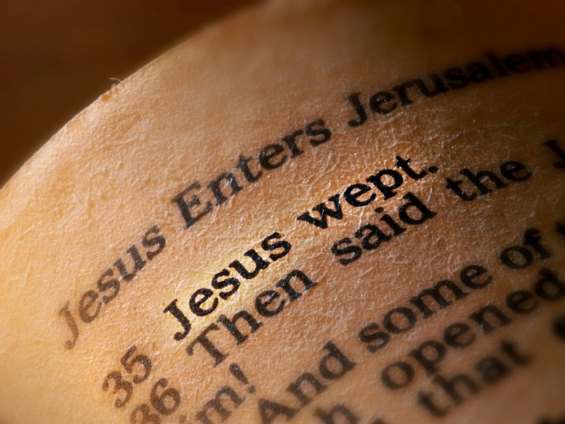
Other Passages
Ten Commandments – Exodus 20:1-17
Beatitudes – Matthew 5:3-12
Sermon on the Mount – Matthew 5-7
Three Angels’ Messages – Rev 14:6-12
Psalms 119 – Spurgeon, Wilberforce, Henry
John 11:35

Slide 28
Strategy: Choose a Book
 | Chapter | Verse | Words |  |  | Chapter | Verse | Words
Obadiah | 1 | 21 | 669 |  | 3 John | 1 | 14 | 294
Haggai | 2 | 38 | 1,130 |  | 2 John | 1 | 13 | 298
Nahum | 3 | 47 | 1,284 |  | Philemon | 1 | 25 | 430
Jonah | 4 | 48 | 1,320 |  | Jude | 1 | 25 | 608
Habakkuk | 3 | 56 | 1,475 |  | Titus | 3 | 46 | 896
Zephaniah | 3 | 53 | 1,616 |  | 2 Thessalonians | 3 | 47 | 1,022
Malachi | 4 | 55 | 1,781 |  | 2 Peter | 3 | 61 | 1,553
Joel | 3 | 73 | 2,033 |  | 2 Timothy | 4 | 83 | 1,666
Ruth | 4 | 85 | 2,574 |  | 1 Thessalonians | 5 | 89 | 1,837
Song of Solomon | 8 | 117 | 2,658 |  | Colossians | 4 | 95 | 1,979
Micah | 7 | 105 | 3,152 |  | Philippians | 4 | 104 | 2,183
Lamentations | 5 | 154 | 3,411 |  | 1 Timothy | 6 | 113 | 2,244
Amos | 9 | 146 | 4,216 |  | James | 5 | 108 | 2,304
Hosea | 14 | 197 | 5,174 |  | 1 Peter | 5 | 105 | 2,476

Slide 29
Ecclesiastes | 12 | 222 | 5,579 |  | 1 John | 5 | 105 | 2,517
Esther | 10 | 167 | 5,633 |  | Ephesians | 6 | 155 | 3,022
Zechariah | 14 | 211 | 6,443 |  | Galatians | 6 | 149 | 3,084
Ezra | 10 | 280 | 7,440 |  | 2 Corinthians | 13 | 257 | 6,046
Nehemiah | 13 | 406 | 10,480 |  | Hebrews | 13 | 303 | 6,897
Daniel | 12 | 357 | 11,602 |  | Romans | 16 | 433 | 9,422
Proverbs | 31 | 915 | 15,038 |  | 1 Corinthians | 16 | 437 | 9,462
Job | 42 | 1,070 | 18,098 |  | Revelation | 22 | 404 | 11,952
Joshua | 24 | 658 | 18,854 |  | Mark | 16 | 678 | 14,949
Judges | 21 | 618 | 18,966 |  | John | 21 | 879 | 18,658
1 Chronicles | 29 | 942 | 20,365 |  | Matthew | 28 | 1,071 | 23,343
2 Samuel | 24 | 695 | 20,600 |  | Acts | 28 | 1,007 | 24,229
2 Kings | 25 | 719 | 23,517 |  | Luke | 24 | 1,151 | 25,640
1 Kings | 22 | 816 | 24,513

Slide 30
Other Strategies
“Weed the garden.”
Memorize the number references!
Schedule it out in a block of time
Memorize sermon texts
Thank the Lord!

Slide 31
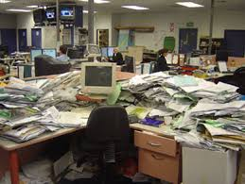

Slide 32
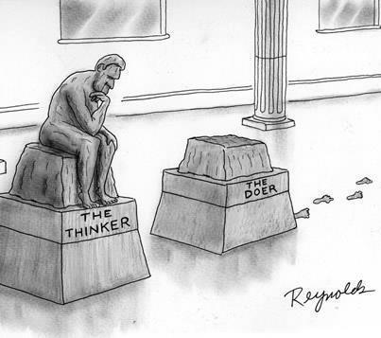
James 1:22 But be ye doers of the word, and not hearers only, deceiving your own selves.

